Slide 1
Networks
Lecture - 2

Slide 2
Networks - Introduction
Network Criteria
Performance
Reliability
Security
Physical Structure
Point to Point
Multi-Point
Physical Topology
Mesh, Star, Bus, Ring and Hybrid
Categories of Networks
LAN, WAN, MAN

Slide 3
NETWORKS
A network is the interconnection of a set of devices capable of communication.
In this definition, a device can be a host (or an end system as it is sometimes called) such as a large computer, desktop, laptop, workstation, cellular phone, or security system.
A device can also be a connecting device such as a router, which connects the network to other networks, a switch, which connects devices together, a modem (modulator-demodulator), which changes the form of data, and so on.
These devices in a network are connected using wired or wireless transmission media such as cable or air

Slide 4
Network Criteria
A network must be able to meet a certain number of criteria.
The most important of these are performance, reliability, and security.
Performance
Performance can be measured in many ways, including transit time and response time.
Transit time is the amount of time required for a message to travel from one device to another.
Response time is the elapsed time between an inquiry and a response.
The performance of a network depends number of users, the type of transmission medium, the capabilities of the connected hardware, and the efficiency of the software.
Performance is often evaluated by two networking metrics: throughput and delay.

Slide 5
Network Criteria
Reliability
In addition to accuracy of delivery, network reliability is measured by the frequency of failure, the time it takes a link to recover from a failure.
Security
Network security issues include protecting data from unauthorized access, protecting data from damage and development, and implementing policies and procedures for recovery from breaches and data losses.

Slide 6
Physical Structures
Type of Connection
A network is two or more devices connected through links.
A link is a communications pathway that transfers data from one device to another.
For visualization purposes, it is simplest to imagine any link as a line drawn between two points.

Slide 7
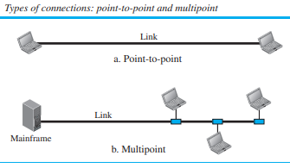
Physical Structures
There are two possible types of connections: point-to-point and multipoint.

Slide 8
Physical Structures
Point-to-Point
A point-to-point connection provides a dedicated link between two devices.
The entire capacity of the link is reserved for transmission between those two devices
When we change television channels by infrared remote control, we are establishing a point-to-point connection between the remote control and the television’s control system. other options for point to point communication is microwave or satellite links.

Slide 9
Physical Structures
Multipoint
A multipoint (also called multi-drop) connection is one in which more than two specific devices share a single link.
In a multipoint environment, the capacity of the channel is shared, either spatially or temporally.
If several devices can use the link simultaneously, it is a spatially shared connection.
If users must take turns, it is a timeshared connection.

Slide 10
Physical Topology
The term physical topology refers to the way in which a network is laid out physically.
Two or more devices connect to a link; two or more links form a topology.
The topology of a network is the geometric representation of the relationship of all the links and linking devices (usually called nodes) to one another.
There are four basic topologies possible: mesh, star, bus, and ring.

Slide 11
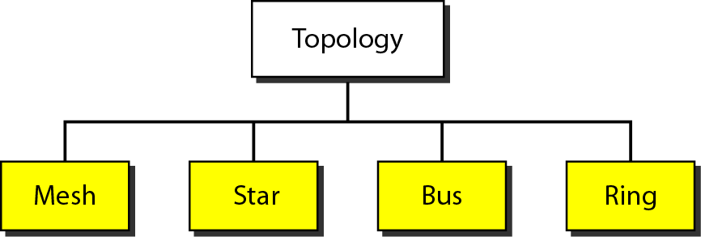
Categories of topology

Slide 12
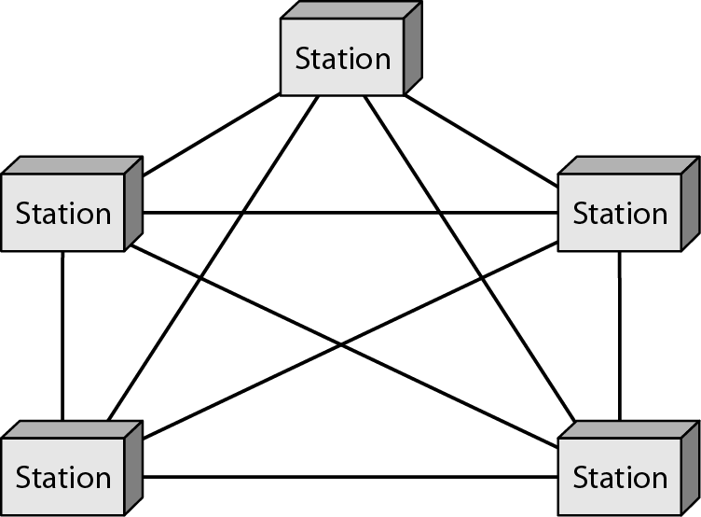
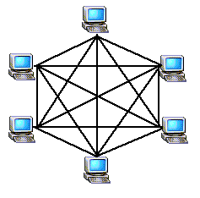
A fully connected mesh topology (five devices)
To link n devices fully connected mesh has:
n ( n - 1) / 2 physical channels (Full-Duplex)
Every Device on the network must have n - 1 ports
Every link is dedicated point-to-point link
The term dedicated means that the link carries traffic only between the two devices it connects
To accommodate that many links, every device must have n-1 input/output ports

Slide 13
Mesh topology - Example
Mesh
Example:
10 devices in mesh has links: n(n-1) / 2
number of links = 10 (10-1)/2 = 45
number of ports per device = n – 1 = 10 –1 = 9
Advantages
Each connection carry its own data load (no traffic problems)
A mesh topology is robust
Privacy or security
Fault identification and fault isolation
Disadvantages
Big amount of cabling
Big number of I/O ports
Installation and reconnection are difficult
Hardware connect to each I/O could be expensive

Slide 14
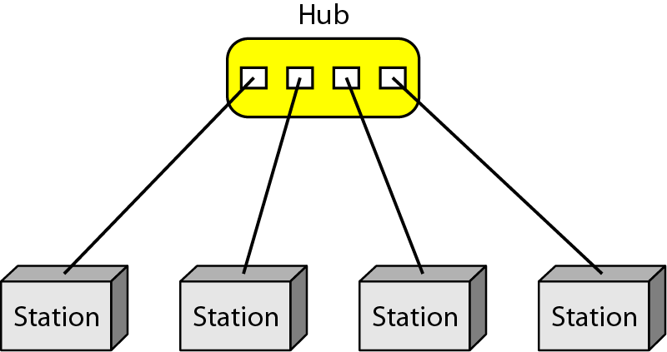
A star topology connecting four stations
Advantages
Less expensive than mesh (1 Link + 1 port per device)
Easy to install and reconfigure
Less cabling Additions, moves, and deletions required one connection
Robustness : one fail does not affect others
Easy fault identification and fault isolation
Disadvantages
Dependency of the whole topology on one single point (hub)
Star:
Dedicated point-to-point to a central controller (Hub)
No direct traffic between devices
The control acts as an exchange

Slide 15
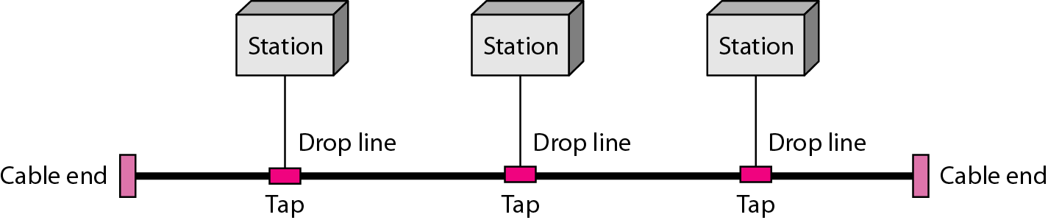
A bus topology connecting three stations
Bus:
It is multipoint
One long cable acts as a backbone
Used in the design of early LANS, and Ethernet LANs
Advantages
Ease of installation
Less cables than mesh, star topologies
Disadvantages
Difficult reconnection and fault isolation ( limit of taps)

Slide 16
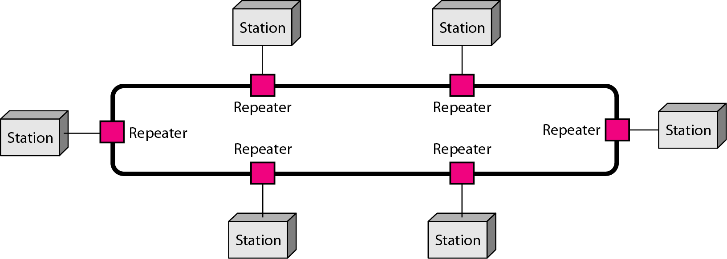
A ring topology connecting six stations
Each device has dedicated point-to-point connection with only the two devices on either side of it
A signal is passed along the ring in one direction from device to device until it reaches its destination
Each devices incorporates a Repeater
Advantages
Easy of install and reconfigure
Connect to immediate neighbors
Disadvantage
Unidirectional
One broken device can disable the entire network.

Slide 17
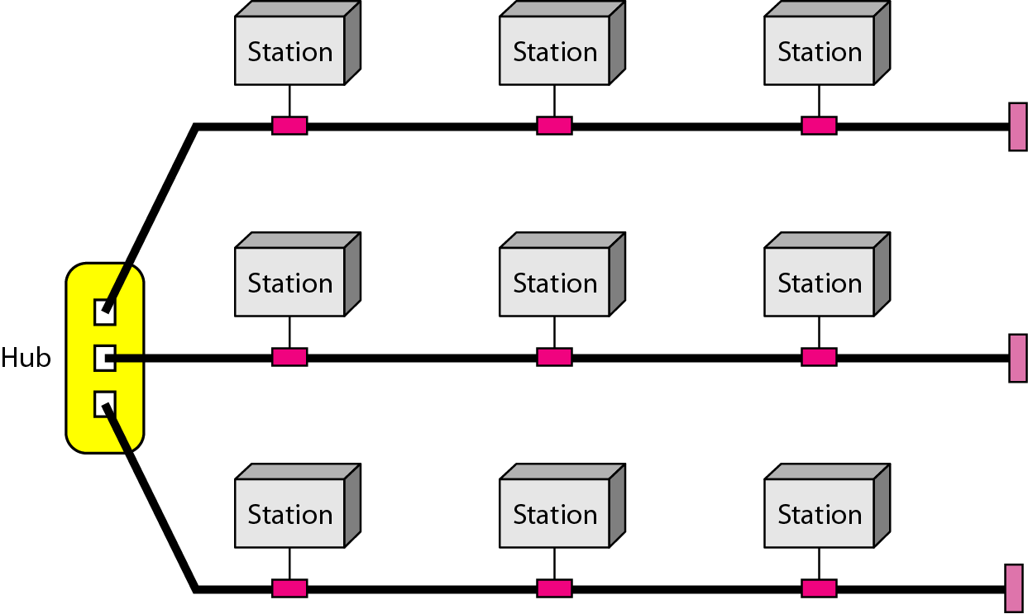
A hybrid topology: a star backbone with three bus networks
Example: having a main star topology with each branch connecting several stations in a bus topology

Slide 18
Categories of Networks
Local Area Networks (LANs)
Short distances (Covers area < 2miles)
Designed to provide local interconnectivity
Wide Area Networks (WANs)
Long distances (Can be worldwide)
Provide connectivity over large areas
Metropolitan Area Networks (MANs)
Provide connectivity over areas such as a city, a campus
Between LAN & WAN, span 10s of miles

Slide 19
Local Area Network
A local area network (LAN) is usually privately owned and connects some hosts in a single office, building, or campus.
Depending on the needs of an organization, a LAN can be as simple as two PCs and a printer in someone’s home office, or it can extend throughout a company and include audio and video devices.

Slide 20
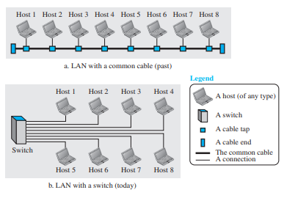
An isolated LAN in the past and today

Slide 21
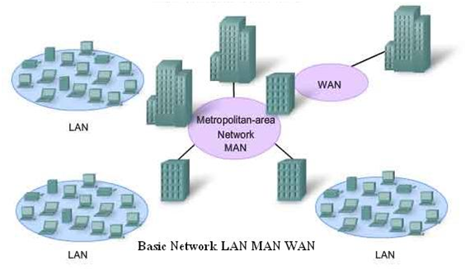
Metropolitan area network
A Metropolitan Area Network is a class of network which serves a large geographical area between 5 to 50 kilometers in range.
This geographical area can include several buildings, such as a college campus, sometimes referred to as a campus network, or an area as large as a city (metropolitan area).

Slide 22
Wide Area Network
A wide area network (WAN) is also an interconnection of devices capable of communication.
However, there are some differences between a LAN and a WAN.
A LAN is normally limited in size, spanning an office, a building, or a campus; a WAN has a wider geographical span, spanning a town, a state, a country, or even the world.
A LAN interconnects hosts; a WAN interconnects connecting devices such as switches, routers, or modems

